Slide 1
DNS

Slide 2
DNS: Domain Name System
People: many identifiers:
SSN, name, passport #
Internet hosts, routers:
IP address (32 bit) - used for addressing datagrams
“name”, e.g., ww.yahoo.com - used by humans
Q: map between IP addresses and name ?
Domain Name System:
distributed database implemented in hierarchy of many name servers
application-layer protocol host, routers, name servers to communicate to resolve names (address/name translation)
note: core Internet function, implemented as application-layer protocol
complexity at network’s “edge”

Slide 3
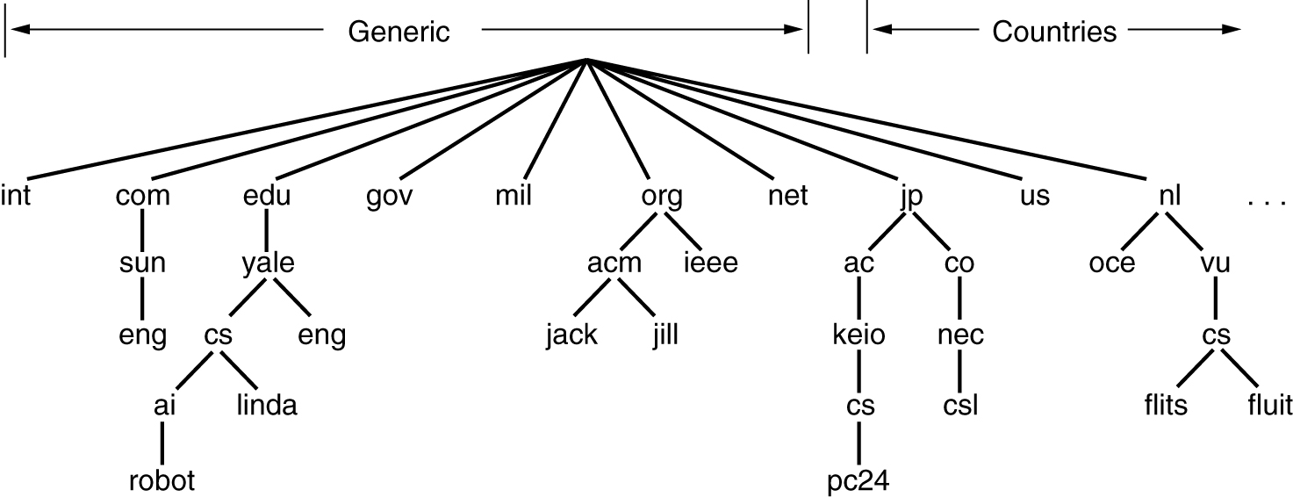
The DNS Name Space
A portion of the Internet domain name space.

Slide 4
DNS
DNS services
hostname to IP address translation
host aliasing
Canonical, alias names
mail server aliasing
load distribution
replicated Web servers: set of IP addresses for one canonical name
Why not centralize DNS?
single point of failure
traffic volume
distant centralized database
maintenance
doesn’t scale!

Slide 5
Distributed, Hierarchical Database
Root DNS Servers
com DNS servers
org DNS servers
edu DNS servers
pbs.org
DNS servers
poly.edu
DNS servers
umass.edu
DNS servers
yahoo.com
DNS servers
amazon.com
DNS servers
Client wants IP for www.amazon.com; 1st approx:
client queries a root server to find com DNS server
client queries com DNS server to get amazon.com DNS server
client queries amazon.com DNS server to get IP address for www.amazon.com

Slide 6

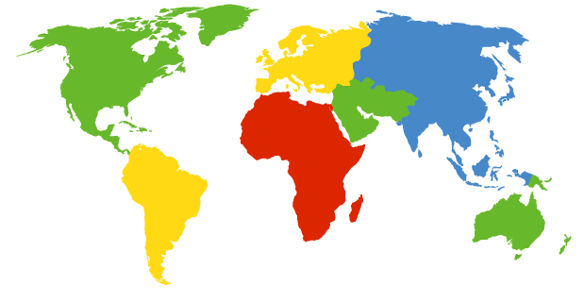
DNS: Root name servers
contacted by local name server that can not resolve name
root name server:
contacts authoritative name server if name mapping not known
gets mapping
returns mapping to local name server
a Verisign, Dulles, VA
c Cogent, Herndon, VA (also LA)
d U Maryland College Park, MD
g US DoD Vienna, VA
h ARL Aberdeen, MD
j Verisign, ( 21 locations)
k RIPE London (also 16 other locations)
i Autonomica, Stockholm (plus 28 other locations)
e NASA Mt View, CA
f Internet Software C. Palo Alto, CA (and 36 other locations)
m WIDE Tokyo (also Seoul, Paris, SF)
13 root name servers worldwide
b USC-ISI Marina del Rey, CA
l ICANN Los Angeles, CA

Slide 7
TLD and Authoritative Servers
Top-level domain (TLD) servers:
responsible for com, org, net, edu, etc, and all top-level country domains uk, fr, ca, jp.
Network Solutions maintains servers for com TLD
Educause for edu TLD
Authoritative DNS servers:
organization’s DNS servers, providing authoritative hostname to IP mappings for organization’s servers (e.g., Web, mail).
can be maintained by organization or service provider

Slide 8
Local Name Server
does not strictly belong to hierarchy
each ISP (residential ISP, company, university) has one.
also called “default name server”
when host makes DNS query, query is sent to its local DNS server
acts as proxy, forwards query into hierarchy

Slide 9
DNS name resolution example
root DNS server
2
Host at cis.poly.edu wants IP address for gaia.cs.umass.edu
iterated query:
contacted server replies with name of server to contact
“I don’t know this name, but ask this server”
3
TLD DNS server
4
5
local DNS server
dns.poly.edu
7
6
1
8
authoritative DNS server
dns.cs.umass.edu
requesting host
cis.poly.edu
gaia.cs.umass.edu

Slide 10
DNS: caching and updating records
once (any) name server learns mapping, it caches mapping
cache entries timeout (disappear) after some time
TLD servers typically cached in local name servers
Thus root name servers not often visited
update/notify mechanisms under design by IETF
RFC 2136
http://www.ietf.org/html.charters/dnsind-charter.html

Slide 11
DNS records
DNS: distributed db storing resource records (RR)
RR format: (name, value, type, ttl)
Type=CNAME
name is alias name for some “canonical” (the real) name www.ibm.com is really servereast.backup2.ibm.com
value is canonical name
Type=MX
value is name of mailserver associated with name
Type=A
name is hostname
value is IP address
Type=NS
name is domain (e.g. foo.com)
value is hostname of authoritative name server for this domain

Slide 12
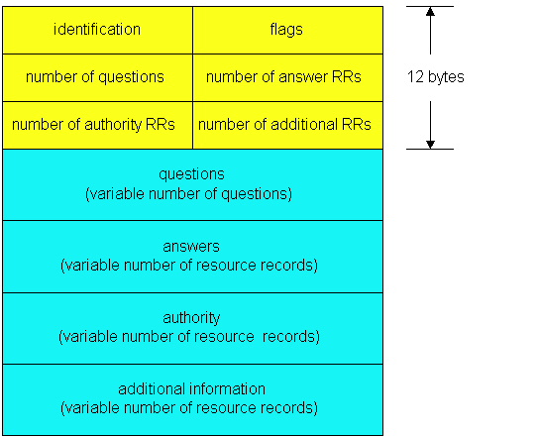
DNS protocol, messages
DNS protocol : query and reply messages, both with same message format
msg header
identification: 16 bit # for query, reply to query uses same #
flags:
query or reply
recursion desired
recursion available
reply is authoritative

Slide 13
DNS protocol, messages
Name, type fields
for a query
RRs in response
to query
records for
authoritative servers
additional “helpful”
info that may be used

Slide 14
Inserting records into DNS
example: new startup “Network Utopia”
register name networkuptopia.com at DNS registrar (e.g., Network Solutions)
provide names, IP addresses of authoritative name server (primary and secondary)
registrar inserts two RRs into com TLD server:
(networkutopia.com, dns1.networkutopia.com, NS)
(dns1.networkutopia.com, 212.212.212.1, A)
create authoritative server Type A record for www.networkuptopia.com; Type MX record for networkutopia.com
How do people get IP address of your Web site?

Slide 15

Summary
The DNS system
The DNS protocol

